Slide 1

Simple Mood Predictor
A simple Python program that predicts your mood.
By: Mike Maeda
December 2025

Slide 2
Project Overview
Core Functionality
User creates or loads a profile
User answers 5 questions (Scale 1–10)
Program predicts mood: happy, sad, stressed, angry, calm, neutral
Results saved to Downloads
Purpose
Practice Python fundamentals in a useful, real-world project.

Slide 3

Program Flow Overview
Start: User Profile
Ask 5 Questions
Predict Mood
Menu / Exit
Auto-Open File
Save Results

Slide 4
The Five Mood Questions
Inputs on a scale of 1–10
Energy ⚡
Positivity ☀️
Stress 😫
Connection 🤝
Control 🧘

Slide 5
Mood Prediction Rules
High Positivity + Low Stress
→ Happy 😄
High Stress + Low Control
→ Stressed 😫
Low Valence + Low Energy
→ Sad 😢
High Stress + Low Valence
→ Angry 😠
Low Stress + High Control
→ Calm 😌
Otherwise
→ Neutral 😐

Slide 6

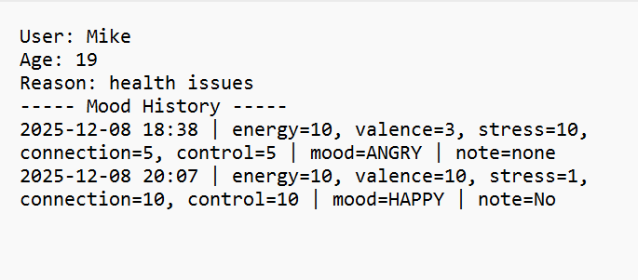
File Storage System
Mike_mood.txt
How it works:
Each user gets a dedicated text file
Saved directly toDownloadsfolder
Format: <username>_mood.txt
2023-10-25 14:30
Scores: [8, 7, 2, 9, 8]
Mood: Hapy
Note: Good coding session!

Slide 7

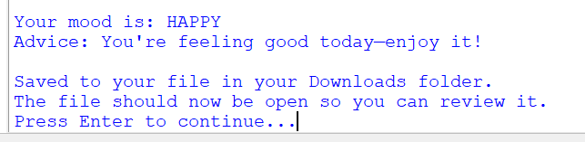
Example Output
[ Screenshot of output text file ]
Example mood history entry generated by the program.

Slide 8

Challenges Solved
✅ Validating Input- Ensuring only numbers 1–10 are accepted
✅ Error Handling- Managing missing user profiles gracefully
✅ File Safety- Creating safe file names from usernames

Slide 9
Concepts Learned in Class
Input/Output
input(), print()
Control Flow
If/elif/else
Loops
While loops
Modular Code
Functions
Data Structures
Dictionaries
Data Persistence
File Input/Output
Program Architecture
Main loop structure / Menu System

Slide 10

Future Improvements
📊 Visualizations
Add graphs or mood trend charts using matplotlib.
🖥️ GUI
Implement a graphical interface using Tkinter.
📅 Summaries
Generate weekly or monthly mood analysis reports.
🔒 Privacy
Add encryption for sensitive user data.

Slide 11

Conclusion
Reliable & User-friendly
Demonstrates key Python concepts
Thank you!
Any questions?

